Slide 1
Snow on Cholera Epidemiology and data handling exercise - Without answer key - Adapted for A level biology students
By Severa von Wentzel &
Mary Doherty
Doctors Without Borders /
Medecins Sans Frontieres (MSF)
Image: Kew Bridge Steam Museum

Slide 2
Snow on Cholera
Snow on Cholera is based on an exercise developed by the London School of Hygiene & Tropical Medicine (LSHTM), a world-leading centre for research and postgraduate education in public and global health.
Medecins Sans Frontieres/Doctors Without Borders (MSF) has adapted and expanded Snow on Cholera as a teaching resource for A level biology students in the UK with the help of a working group of biology teachers and the input of students. In this exercise, the blue headers refer to the pages on the LSHTM web taster session found at: http://dl.lshtm.ac.uk/download/webdev/devwork/epmtastercoursev2/tastercourses/epm101/fe01/page_01.htm.
MSF helps people worldwide where the need is greatest, providing emergency medical aid to people affected by conflict, epidemics, disasters or exclusion from healthcare.

Slide 3
Learning objectives
The presentation in 4 sections (Introduction and Parts I-IV) introduces students to:
epidemiology,
living conditions in mid-19th century London,
Dr. John Snow,
his seminal cholera investigation
cholera in the context of Snow’s times and today.
Illustrates what an epidemiologist considers and does to formulate and revise scientific explanations and models, particularly for an unknown disease.
Encourages students to work actively through the steps of an investigation from:
descriptive epidemiology to hypothesis generation
to analytic epidemiology and hypothesis testing
to devising conclusions and recommendations about the spread and control to prevent further outbreaks.

Slide 4
Index of presentation: Introduction
Introduction to mid-19th C cholera:
Cholera pandemics and epidemiology
Theories on cholera,
Cholera in England and Wales,
John Snow, his theory and hypotheses,
Living conditions, sanitation and water companies in London.

Slide 5
Index: Part 1
Part 1: 1848 – 1853 South London cholera investigation
Epidemiological study comparing cholera mortality among sizeable populations in South London
Data handling exercise
Overview of epidemiological studies
Data handling exercise
Risk
Rate
Descriptive and analytical epidemiology

Slide 6
Index: Part 2
Part 2: 1854 Broad Street outbreak investigation
Specific outbreak investigation examining
circumstances around outbreak in Soho, London.
Iconic map
Outlying cases
Epidemic curve
Why did the epidemic stop?
Causal relationship
Review: steps in Snow’s investigation

Slide 7
Introduction: Cholera pandemics
Cholera has been one of most virulent killers in history: millions succumbed to the 7 cholera pandemics since the first in 1817. It became the first truly global disease and also the most feared.
Six occurred during the 19th C (1817-1923), causing significant disruption and high mortality in their sweep across Europe. Before the 19th Century cholera was practically unknown in Europe.
The seventh pandemic began in Indonesia in 1961 and is still on-going, but thanks to medical and other advances fewer people have died from it. The first six pandemics came from classical strains, the seventh from El Tor.

Slide 8
Endemic, epidemic, pandemic
Action for students: Define endemic, epidemic and pandemic

Slide 9
Cholera in 19th C in England and Wales
Of the three pandemics of Asiatic cholera (1817-23, 1826-37 and 1846-63) two reached the British isles.
This exercise focuses on the outbreaks in London during the Third Asiatic pandemic of 1846-63.
England and Wales were hit with deadly force - high mortality in short period of time:
“Whenever cholera broke out -- which it did four times between 1831 and 1854 -- nothing whatsoever was done to contain it, and it rampaged through the industrial cities, leaving tens of thousands dead in its wake.” -Summers, Judith. Soho -- A History of London's Most Colourful Neighborhood, Bloomsbury, London, 1989

Slide 10
The mystery of cholera’s cause and transmission
Action for students:
Travel back in time to the middle of the 19th Century for this exercise.
Follow Dr. John Snow without trying to fill in the gaps with today’s knowledge of cholera!
You are frightened! Physicians struggle to find the cause and discover treatments for cholera - there is no cure. (It is remarkable that you can consider cholera without fear today!)
There are debates whether diseases such as cholera could only be transferred from person to person or whether it is (also) possible for them to be transferred via a vector, an “animate intermediary in the indirect transmission of an agent that carries the agent from a reservoir to a susceptible host.”(CDC epi glossary)
Notes:
Solving the mystery of transmission was perhaps as big an achievement as finding a cure for HIV / AIDS today (http://www.ph.ucla.edu/epi/snow/Snow_Laura_Ball.pdf)

Slide 11
Cholera outbreaks in 19th C in England and Wales
1831-32: severe outbreak (around 20,000 dead) across many British towns and cities including London. England’s Cholera Prevention Act followed the flawed and later repealed Quarantine Act of 1825.
1848-49: another severe outbreak (around 10,000 dead in 3 months in London; around 53,000 dead in England and Wales).
1853-54: There were a few cases in 1853 and the first half of 1854. Then, after August 31, 1854 there was the “most terrible outbreak of cholera which ever occurred in this kingdom” (Dr. John Snow, 1855)
You are here
1865-66: The fourth pandemic (1863-1879) only affected areas served by the East London Waterworks Company. (Source: http://ije.oxfordjournals.org/content/31/5/908.long; http://www.epidemiology.ch/history/papers/eyler-paper-1.pdf)
Notes:
In 1865-66, the East London Waterworks Company was found to be illegally pumping water from a contaminated reservoir – but this is jumping ahead. We do not have proof at Snow’s time that cholera was caused by sewage.

Slide 12
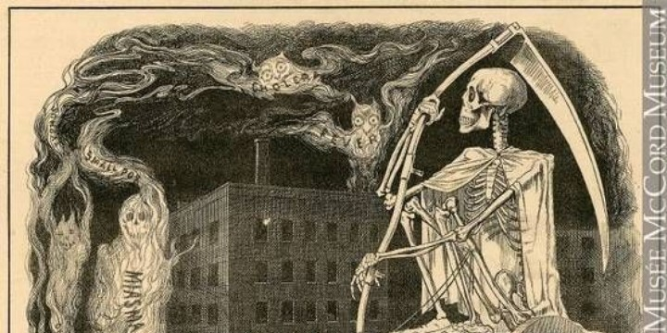
Prevailing thinking
Image: https://suite.io/rosemary-e-bachelor/4ckt25d
Miasma theory was the prevailing 19th C dogma of public and medical community alike.
The theory of indirect and airborne transmission held that cholera was caused by the smell of the bad air, miasmata, a poisonous vapour with suspended particles of decaying matter and a foul smell.
At the time miasma theory made sense to most as disease and epidemics were concentrated in poor, filthy and foul-smelling city neighborhoods.
Physicians tended to believe that cholera was a condition of the blood. (http://www.ph.ucla.edu/epi/snow/Snow_Laura_Ball.pdf)
Some believed that cholera was related to altitude.
Most believed it was not contagious.
Notes:
Sewage-contaminated water was also viewed as a source of miasmata because of the smells of putrefaction and decomposition. There were those who believed that cholera was the retribution for sinful acts just as some people believed with HIV/AIDS in our time.

Slide 13
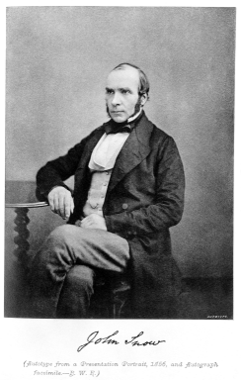
Dr. John Snow (1813-1858)
General practitioner who developed a practice in anaesthesia along with studies of respiration.
Vegetarian and teetotaller, he lived in Soho, London, where somewhat ironically a pub remains named after him today.
Familiar with what was known about cholera thanks to first hand experience of the disease in his native York and London outbreak of 1832, but without prior experience of epidemiology.
He made a radical departure from the dominant miasma theory of air-borne transmission in both editions of On the Mode of Communication of Cholera (1849 and 1855)
He “proposed that cholera was attributable to a self-replicating agent which was excreted in the cholera evacuations and inadvertently ingested, often, but not necessarily, through the medium of water.” (http://johnsnowbicentenary.lshtm.ac.uk/about-john-snow/)
Image: http://www.sciencemuseum.org.uk/broughttolife/people/johnsnow.aspx
Further info on John Snow: http://www.bbc.co.uk/history/historic_figures/snow_john.shtm;
LSHTM podcast http://johnsnowbicentenary.lshtm.ac.uk/about-john-snow/#sthash.Idi4CNMf.dpuf
Notes:
A controversial figure in Victorian England, Snow treated Queen Victoria with chloroform anaesthesia for the birth of two of her children. He was a strong supporter of the formation of temperance societies (abstinence from alcohol).
The pub is located on the site of the original Broad Street (now Broadwick) pump (a typical Victorian pump) marked by a pink granite stone, but mentioning this on the slide would be jumping ahead...
The residents of the water lanes of York next to the River Ouse had always obtained their water supply from the Ouse. Yet, following a local outbreak of cholera in this district, they switched to the piped water in York and the outbreak stopped. When the residents switched back to using the river water and cholera struck again, drawing water from the Ouse was prohibited.

Slide 14
Classic epidemiological investigation
In Snow’s days, the science of public health and statistics, epidemiology, was not established. In this exercise it is important to understand his epidemiologic research into the causes and factors which influence the risk of cholera disease in the context of his time.
Whilst there was much medical and scientific interest in cholera and many publications, Snow’s shift of focus from that of a clinician concerned with the health of an individual to an investigation of an epidemiologist concerned with the collective health of the people in a community or area – public health – was pioneering.
Using a systematic approach, he collected epidemiological evidence in a bid to convince other practitioners of his theory of cholera.

Slide 15
Part 1 (1848-49) and Part 2 (1854): 2 different types of investigations
Snow used two types of evidence:
He generated the first type of evidence by comparing cholera mortality among sizeable populations who were exposed to water of varying degrees of sewage contamination supplied by different water companies.
2. The second type was based on specific outbreak investigations, which served to make his hypothesis on the faecal oral route of cholera transmission plausible. He got a lot of evidence by investigating the circumstances of the outbreaks. He examined water and reconstructed how the water supply could have become infected.
Source: http://www.epidemiology.ch/history/papers/eyler-paper-1.pdf
PART 1:
First we focus on the
1848 - 1853 South London cholera investigation
PART 2:
Then we look at the investigation of the localised Broad Street outbreak of 1854

Slide 16
Snow’s basic theory in 1849
In On the Mode of Communication of Cholera (1849), Snow relied on analogical reasoning based on cholera’s pathological evidence. He believed cholera to be a local disease of the gut:
He observed that cholera affected patients with local abdominal symptoms rather than beginning with general symptoms like other epidemic diseases.
This suggested to him that cholera was caused by morbid material or poison and acted as a local irritant to the surface of the stomach and intestines and produced the pain, vomiting, diarrhea and dehydration characteristic of the disease. The cholera poison ought therefore to be present in patients’ intestinal discharges.
In the early stages of the disease, Snow found cholera to respond to treatments acting locally such as opium, chalk or catechu (extract of Acacia).
Source: http://www.epidemiology.ch/history/papers/eyler-paper-1.pdf
Notes:
The second greatly expanded edition of his pamphlet published in 1855 was more famous, but we do not want to jump ahead in time. The 1855 edition includes the anecdotal material and conclusions of the earlier edition.

Slide 17
Snow’s hypotheses
A hypothesis is a specific statement regarding the relationship between two variables: exposure and disease outcome. If there is an association, the exposure is the risk factor of the disease.
Snow made inferences about how, when and where transmission may have happened, on which he based his hypotheses on the nature and mode of communication of cholera:
that cholera can be communicated from the sick to the healthy;
that disease is communicated by "morbid matter" (today referred to as infectious agent) which has the property of multiplying in the body of the person it attacks;
that the morbid matter producing cholera must be introduced into the alimentary canal
that water supplies appeared to be able to disseminate the morbid matter from the sick to the healthy.
Notes:
It has been variously pointed out that Snow collected data based on his preconceived ideas, rather than generating a hypothesis based on his data. (e.g., Brody H et al; Cameron D et al)

Slide 18
Issues with observed associations
Does the association exist? Could it be by chance (e.g., inadequate sample size)? Is there bias?
Proving a causal relationship between an exposure and a disease is very difficult, and associations between exposures and disease are not all causal.
Potential for considerable ascertainment bias (systematic failure to equally represent all classes of cases or people supposed to be represented in a sample, also called surveillance bias)
Unusual events in association with a particular factor are more likely to be remembered
Source: http://ocw.jhsph.edu/courses/fundepiii/PDFs/lecture18.pdf
Notes:
“Bias is a systematic error in the design, conduct or analysis of a study that results in a mistaken estimate of an exposure’s effect on the risk of disease” (Schlesselman and Stolley, 1982).

Slide 19
Living conditions during Snow’s time
Action for students: Snow’s observed associations were set in Victorian England. What were some of the social and environmental conditions at the time?

Slide 20
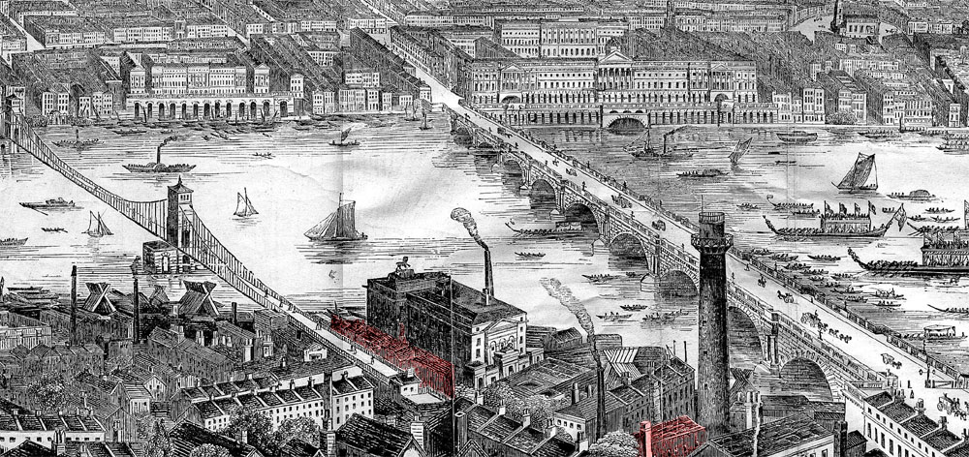
London panorama
Source: http://www.ph.ucla.edu/epi/snow/1859map/lambeth_waterworks_a2.html

Slide 21
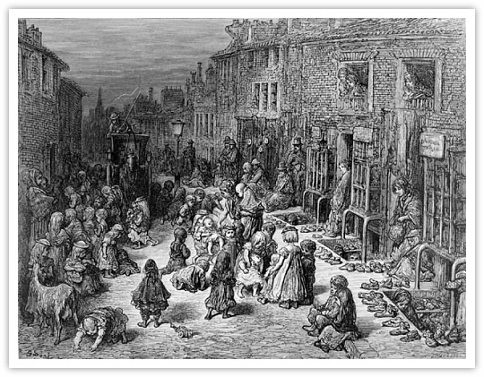
London slum
“By the middle of the 19th century, Soho had become an insanitary place of cow-sheds, animal droppings, slaughterhouses, grease-boiling dens and primitive, decaying sewers. And underneath the floorboards of the overcrowded cellars lurked something even worse -- a fetid sea of cesspits as old as the houses, and many of which had never been drained. It was only a matter of time before this hidden festering time-bomb exploded.”
-- Summers, Judith. Soho -- A History of London's Most Colourful Neighborhood, Bloomsbury, London, 1989
Image: http://www.historyisnowmagazine.com/blog/2014/4/5/body-snatchers-and-dickens-london-shocking-tales-of-crime-in-19th-century-britain#.U6QoV_ldVuI=

Slide 22
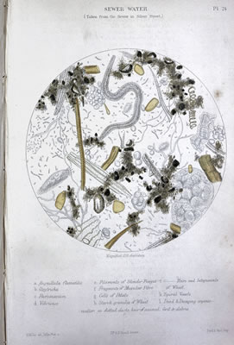
Sanitation
By the arrival of the 19th century, the River Thames had become the most contaminated river in the world.
Toilets were widely introduced in London between 1830 and 1850: main sewers were introduced in the 1840s.
The sewers, elongated cesspools with overflows at the end emptied into the River Thames, which was also a dumping ground for animal and industrial wastes.
The Great Stink of 1858 – the offensive stench from fermenting sewage in the river Thames that almost led the government to abandon Westminster - finally helped push through a bill to reform the river. (Source: http//:www.choleraandthames.co.uk/cholera-in-london/the-great-stink/)
Sewage water
Image: Wellcome Library, London

Slide 23
Water companies and community hand pumps
During the 19th century, drinking water was supplied to an increasing number of houses by private, profit-making companies via a network of pipes, but many households still depended on drawing water from street pumps.
The water companies did not filter or treat their water in 1848-49 or 1853-54.
Companies competed for customers house by house, resulting in overlap between the areas supplied by the different companies. It also meant that the patients were indistinguishable save for the source of their water.
Source: http://www.epidemiology.ch/history/papers/eyler-paper-1.pdf

Slide 24
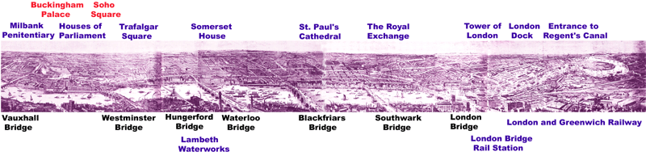
River Thames
Action for students: Where would water be most polluted with sewage – upstream or downstream from London?
Source: Wood engraving by Smyth of London in 1844, published as a supplement in the Illustrated London News, January 11, 1845. in Barker F and Jackson P., London 2000 Years of a City & It's People, 1974.

Slide 25
Epidemiology
To investigate cholera, Snow used what would become known as epidemiological methods. These were not established or commonly accepted at the time.
He assumed that diseases follow patterns and asks what, who, when, where, how, why and what next?
The objective of studying “the distribution and determinants of health-related states in specific populations, and the application of this study to control health problems” was to direct public health action (CDC)
Further info on epidemiology:
http://www.bmj.com/about-bmj/resources-readers/publications/epi demiology-uninitiated/1-what-epidemiology
http://www.cdc.gov/excite/classroom/intro_epi.htm
https://www.uic.edu/sph/prepare/courses/PHLearning/EpiCourse/6InvestigatingAnOutbreak.pdf

Slide 26
PART 1: 1848-49 cholera outbreak
Page 1 of LSHTM link
During the 1848-49 cholera epidemic in London, the "water of the...Southwark [and] Vauxhall, and Lambeth [companies], is by far the worst of all those who take their supply from the Thames." - Snow, John. Communication of Cholera, 1855
Both took water directly from the River Thames where it flowed through London and was contaminated by its various wastes. Lambeth Waterworks Company drew water near the Hungerford Bridge and the Southwark Water Company collected it near London Bridge.
By 1854 the two companies accounted for about two thirds of the mains water supply to South London households. (http://ije.oxfordjournals.org/content/31/5/908.long#ref-19)

Slide 27
High resolution map available at: http://www.ph.ucla.edu/epi/snow/snowmap2.pdf
Map of 1848-49 South
London by water supplier (1)
Snow tabulated cholera deaths in relation to geographic areas served by different companies along with this map. Although he lacked exact information about the sources of water for the different districts, he had enough information to suggest that districts in the South and East supplied by water companies drawing water from more polluted parts of the Thames had the highest mortality rates.
The green area was served by the Southwark and Vauxhall Company
The pink area by the Lambeth Company
The grey area in between is where the two companies' pipes were intermingled.

Slide 28
Map of 1848-49 South
London by water supplier (2)
Action for students:
What does the map on the previous slide show?
When he related the geographic distribution of cholera deaths to water suppliers, what kind of study was it?
Notes:
Group level can look at factors such as religion, race, climate, geography rather than the individual level of life style or genes, for example. You may wish to explain ecological fallacy and biological fallacy, where there unit of correlations based on groups and individuals is switched.

Slide 29
Incidence and prevalence
Action for students: Define incidence and prevalence

Slide 30
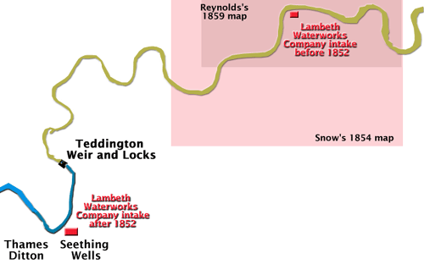
Lambeth Company moves upstream
Source: www.chnri.org
"London was without cholera from the latter part of 1849 to August 1853.
During this interval....Lambeth Company removed their water works, in 1852, from opposite Hungerford Market to Thames Ditton; thus obtaining a supply of water quite free from the sewage of London."- Snow, John. Communication of Cholera, 1855, p. 68
This was more upstream and thus uncontaminated by London sewage. The Southwark and Vauxhall Company continued to draw water from the Thames near London Bridge in London.

Slide 31
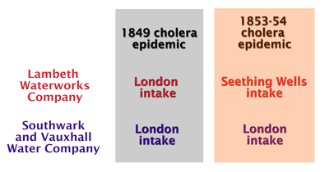
Cholera outbreak in 1853 pandemic
Page 2 of LSHTM link
The fact that Lambeth moved its source between outbreaks provided John Snow with an ideal opportunity to test his hypothesis with a real-life negative public health event through a observational study in South London.
He identified and defined populations at risk and the source or vehicle of infection (the exposure), which could then be controlled or eliminated.
Source:www.chnri.org

Slide 32
The Grand Experiment
The outbreak provided an ‘experiment of nature’ from which Snow sought to learn, in order to have appropriate control and prevention measure implemented.
"The experiment, too, was on the grandest scale. No fewer than three hundred thousand people of both sexes, of every age and occupation, and of every rank and station, from gentlefolk down to the very poor, were divided into two groups without their choice, and, in most cases, without their knowledge; one group being supplied with water containing the sewage of London, and, amongst it, whatever might have come from the cholera patients, the other group having water quite free from such impurity." - Snow, 1855, p. 75.
Notes:
Such an experiment would be unethical, if set up by someone on purpose.

Slide 33
Epidemiological studies
Epidemiologists can use different types of studies, which, put simply, are either experimental or observational studies.
In experimental ones, epidemiologists have control over circumstances from the beginning (clinical or community trial).
In the more common observational study such as Snow’s, they do not. Observational studies are either descriptive or analytical.

Slide 34
Observational study
In an observational study, the investigator does not intervene, but merely seeks to observe and quantify the relationship between an exposure and a health outcome (disease variable).
There are three types of observational studies:
cohort studies,
case-control studies, and
cross-sectional studies (prevalence studies)
Case-control and cohort studies offer a temporal dimension: there are prospective (going forward) or retrospective (looking back) study designs. Thanks to the temporal dimension, case-control and cohort studies can measure disease occurrence and its association with an exposure. This means they can look at the cause and effect relationship.
Cross-sectional studies look at the data on disease and exposure at one particular time point, a slice in time. They cannot examine the cause and effect relationship.
Notes:
Observational studies are cohort studies, case-control studies and cross sectional surveys. Others are randomised control trials and case reports.

Slide 35
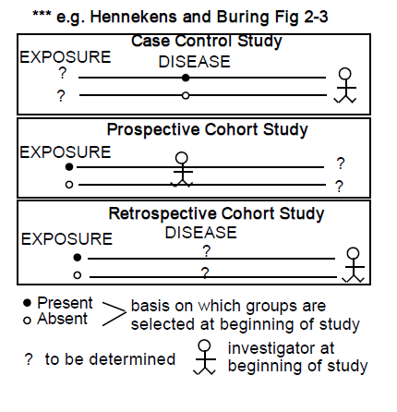
Cohort and case-control studies
Action for students: Snow compared different exposure groups, but did not assign the exposure. What kind of study is it?
Source: http://www.med.mcgill.ca/epidemiology/hanley/IntMedResidents/unit7_epi_sept05.pdf

Slide 36
Shoe-leather epidemiology (1)
When cholera reappeared in London in 1853 Snow followed a systematic scientific approach and did a very thorough job finding out the source of water of houses affected by cholera deaths in the areas of mixed water supply.
John Snow asked permission to obtain from William Farr the addresses of people who died of cholera in the districts which received water supplies from both the Southwark & Vauxhall and the Lambeth companies and got help from the local curates.
Notes:
The local curate helped with the interviews of every single house that had registered a death and the follow up. This was very modern at the time.

Slide 37
Shoe-leather epidemiology (2)
He then visited the homes of all recorded cholera deaths in these districts, to get information about which company supplied water to the household.
He managed to record information from 330 out of the 334 households with questionnaires. He did this by going from house to house to make enquiries.
Today, this type of gathering information for epidemiological studies by direct inquiry among the people, for example, by walking from door to door and asking questions of every householder is often called shoe-leather epidemiology since it involves so much walking that your shoes may wear out!

Slide 38
Source of water and number of deaths (1)
The table shows his results for the first 334 deaths.
Source of Water | Number of deaths
Southwark & Vauxhall | 286
Lambeth Company | 14
Direct from river | 22
Pumpwells | 4
Ditches | 4
Unknown | 4

Slide 39
Source of water and number of deaths (2)
Page 3 of LSHTM link
Action for students: On the basis of these figures, which company is more likely to be transmitting "morbid matter" causing cholera?

Slide 40
Table with estimated denominator
Page 4 of LSHTM link
In a cohort approach, you can start with the denominators of known sizes and then determine the numerators. In order to estimate the denominator, Snow obtained information on the number of houses in London whose water was supplied by each of the two water companies. Snow noted the source of water in the houses of all those who died of cholera from 8th July to 26th August 1854 (before the spike at the end of August!).
Source of water | Total number of houses supplied | Number of cholera deaths
Southwark & Vauxhall | 40,046 | 1263
Lambeth | 26,107 | 98
Other | 256,423 | 1422
The denominator was the number of houses and the numerator the number of deaths in houses supplied by different companies.

Slide 41
Ideal denominator
Page 5 of LSHTM link
Action for students:
Are there are problems with using a general
total of houses supplied by each company as
a denominator?

Slide 42
Risk
Action for students:
What is the risk by source of water?
Why did Snow calculate the number of deaths per 1,000 persons?
3. How much more dangerous was it to drink Southwark and Vauxhall water than Lambeth water (to the nearest whole number)?

Slide 43
Hypothesis and data
Action for students: Is Snow’s hypothesis of indirect cholera transmission carried by water necessarily supported by the data? Is this data more convincing than the data in the first table?

Slide 44
Rate
Action for students: What kind of rate is it, and why are rates useful?

Slide 45
Descriptive epidemiology
Page 6 and 8 of LSHTM link
Snow started with descriptive epidemiology, which is a way of organising and summarising health-related data according to person, place and time (who? where? when?) with his questionnaire and shoe-leather epidemiology.
He looked for evidence of cholera’s cause and risk factors, so that he could formulate testable hypotheses.
He obtained information on the number of cholera deaths (the numerator) and the number of households supplied by water (the denominator). Snow used death certificates for the number of deaths, company reports for the source of water as well as individual enquiry. This allowed him to describe the number of cases of cholera in different areas relative to the size of the population at risk.

Slide 46
Analytical epidemiology
Snow then went on to analytical epidemiology which seeks to quantify the relationship between exposure and outcome (why? how?).
A key feature of analytical epidemiology is the comparison group that provides baseline data. The comparison group can make it possible to find that a certain characteristic is associated with the disease, if those with it are more likely to develop a certain disease than those without it.
Snow looked for cause and effect by comparing the death rates from cholera in different areas, in order to find an association between water source and the risk of death from cholera.
Today, the most common types of analytic epidemiological studies in field investigations are retrospective cohort studies and case-control studies.

Slide 47
PART 2: Spike in cholera cases in August 1854
News of a severe localised outbreak of cholera in Soho, nearer the centre of London, interrupted John Snow's work investigating the Lambeth and the Southwark & Vauxhall water companies at the end of August 1854.
Outbreak was confirmed with 616 fatal cases.
It had its onset between 19 August and 30 September 1854 during a heat wave.
Notes:
This is the second type of evidence Snow was gathering.

Slide 48
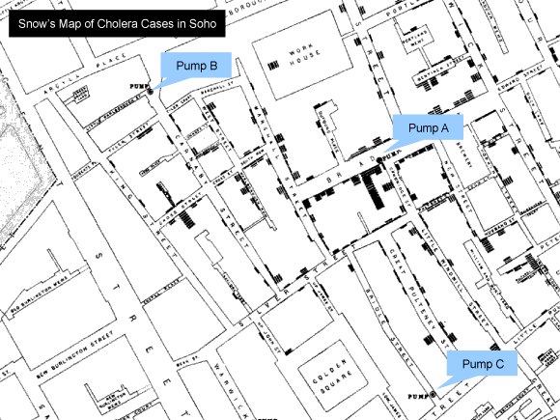
Snow’s iconic map of 1854 cholera cases
When John Snow made this map of the Golden Square area, with a line showing where each person who had had a fatal case of cholera had lived, and the position of the public water pumps, he noticed clusters.
Clusters are aggregation of cases over a particular period in a given area without regard to whether the number of cases is more than expected.
High resolution maps: http://www.ph.ucla.edu/epi/snow/highressnowmap.html
Interactive visualisation of the 1854 cholera outbreak, data of which was based on the original map prepared by Snow:http://www.evl.uic.edu/kreda/vis/snowcholera/
Notes:
Note that the map shows number of deaths, not the rate.

Slide 49
Maps
Action for students: Why can it be more useful to show data pictorially? What kind of map is it? What is not represented in a spot map?
Notes:
Drawing maps was not unusual at the time

Slide 50
Likely source of outbreak
Page 9 of LSHTM link
Action for students:
Looking at the geographical distribution
of cases (the black lines), what was
the most likely source of the outbreak?

Slide 51
Broad Street pump
Page 10 of LSHTM link
Although over 500 cases within 10 days took hold over a radius of 250 yards with the Broad Street pump at its centre in the Golden Square area, the recorded data did not seem to imply that the pump and the outbreak were related (deaths closer to other pumps and unaffected establishments close by).
Snow questioned residents of the deceased who lived near pump B and C who told him that the water from Pump B was disgusting and that Pump C was out of reach for most residents of the area.
People from further afield drew water from the Broad Street pump, owing to its reputation as colder and more carbonated than the water from surrounding pumps. Children and adults stopped to drink from the pump on their way to school and work each morning.
Source: http://www.ph.ucla.edu/epi/snow/Snow_Laura_Ball.pdf

Slide 52
Outlying cases (1)
Snow found explanations for the exceptions within that radius that transformed the apparent inconsistencies into evidence supporting his theory. Outliers can supply important clues.
None of the workers at the Broad Street brewery had cholera: they were very close to pump A, but tended to drink beer rather than water. The brewery also had its own well.
Likewise the Poland Street Workhouse only recorded five deaths among its inmates.
An elderly widow in West Hampstead (an area some distance away, which was free of cholera) liked the taste of Broad Street water, so she had a bottle brought to them every day from the pump. The fact that she and her visiting niece died of cholera was in Snow’s view “the most conclusive”. - Snow J. On the Mode of Communication of Cholera. London: Churchill, 1855, pp. 31–32.

Slide 53
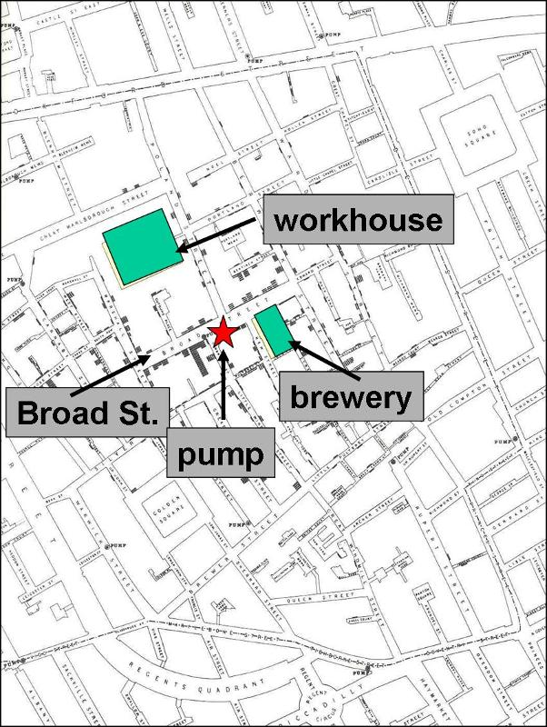
Outlying cases (2)
Source: http://sphweb.bumc.bu.edu/otlt/MPH-Modules/PH/Outbreak/spotmap.jpg

Slide 54
Soho outbreak
Action for students: What kind of study did Snow conduct of the Soho outbreak?

Slide 55
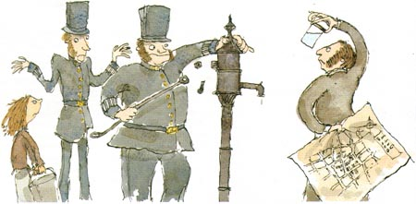
Page 11 of LSHTM link
Image: http://www.ph.ucla.edu/epi/snow/graphics/cricketfig6.jpg
Snow became convinced that the Broad Street pump was the source of the outbreak, and thus that transmission of cholera was indirect and carried by water (vehicle-borne rather than air-borne). Thus, the vehicle had to be decontaminated or eliminated. Indeed, later investigations showed that the superficial pump was probably contaminated by infected material, fecal matter.
Based on his detailed study which also noted the pump’s proximity to a sewer, he persuaded the local authorities to implement a control measure immediately – and so the pump handle was removed on the 8th September 1854.

Slide 56
Recommendations
The recommendation to remove the pump handle has come to be known as an international symbol of public health.
Since his other recommendations for prevention - personal hygiene, boiling of soiled bedclothes of patients, isolation and quarantine, improved waste disposal, drainage, provision of clean water and such measures – were also supported by sanitation reformers and proponents of the miasma theory, improvements followed.
Snow’s intervention is an example of how epidemiology can provide enough information to support effective action.

Slide 57
Steps in Snow’s study
Snow characterised cases and population at risk by person, place and time.
Based on this descriptive epidemiology, he formulated testable hypotheses.
He compared comparable groups in a thorough study to test them (analytical epidemiology).
He then advised the authorities to remove the pump handle, the water intake of the Southwark & Vauxhall Company and to take other measures for better hygiene and sanitation.

Slide 58
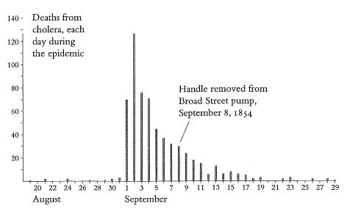
Epidemic curve of the Broad Street outbreak
The graph shows the time distribution of the date of onset of the fatal cases of cholera, disease change over time
Source: http://safedrinkingwaterdotcom.files.wordpress.com/2013/02/13-handle-removed-from-pump.jpg

Slide 59
Epidemic curve (1)
Action for students: What is an epidemic curve?

Slide 60
Epidemic curve (2)
Action for students: What can its shape
tell you?

Slide 61
Why did the epidemic stop?
Action for students: Why did the epidemic stop?

Slide 62
Alternative explanations
Action for students: What could
be alternative explanations?

Slide 63
Outbreak description
Action for students: How would you describe the outbreak based on the epi curve on a previous slide?

Slide 64
Outbreak explanation
Action for students: How would you explain the outbreak?

Slide 65
Causal relationship (1)
Page 11 of LSHTM link
Action for students: What are the criteria that must be fulfilled to prove a causal relationship?

Slide 66
Causal relationship (2)
Action for students: Did John Snow
prove that contaminated drinking
water causes cholera?

Slide 67
Causal relationship (3)
Although Snow worked before the era of bacteriology his observations and deductions would still lead him to clear descriptions and valid theories about the nature and the mode of communication of cholera.
The Snow cholera studies provided good evidence for the causal relationship of the association. They demonstrated enough information supporting the idea that water could serve as a vehicle for transmitting cholera and of effective action, but the input of laboratory science was needed to prove causation.

Slide 68
Review of epidemiological investigation
Action for students:
While watching “Mike Jay on John Snow and the Soho cholera outbreak of 1854 – The Broadwick Street pump handle and the birth of epidemiology” identify steps of an outbreak investigation in Snow’s studies. Note that these do not necessarily all get undertaken nor do they have to occur in this order.
Clip:
http://www.wellcomecollection.org/explore/time--place/topics/london/video.aspx?view=mike-jay-on-john-snow-and-the&gclid=CN7k3P3yir8CFQEUwwod-TcA9w#

Slide 69
Mixed reviews
The public came to benefit from Snow’s contribution of the water-borne theory of cholera eight years after Snow’s death. Upon cholera’s return to England in 1866, the disease was kept under control by London physicians “by the following of the light of his [Snow’s] researches.” (Thomas Snow, “Dr. Snow on the Communication of Cholera,” The Times, 20 November 1885: 4.)
However, Snow’s investigation received mixed reviews at the time – his ideas were too controversial and novel for most of his contemporaries.
If the scientific community and public paid any heed at all, it remained skeptical about Snow’s findings:
“… we see no reason to adopt this belief. We do not find it established that the water was contaminated in the manner alleged …, nor is there before us any sufficient evidence.” (General Board of Health, Report of the Committee of Scientific Inquiries in Relation to the Cholera Epidemic of 1854, London: Eyre and Spottiswoode, 1855: 52.)
Source: http://www.ph.ucla.edu/epi/snow/Snow_Laura_Ball.pdf

Slide 70
So who discovered cholera?
The Italian scientist Filippo Pacini (1812-83) identified the comma shaped bacterium, named it vibrio cholerae and proposed germ theory in 1854. His work remained obscure to the scientific community until one year after his death, and Vibrio cholera Pacini 1854 was not adopted until 1965.
Until then, the German bacteriologist Robert Koch (1843-1910), the founder of the science of bacteriology, had been accorded credit for the discovery of the cholera bacillus in 1884.
In spite of Snow’s work and Pacini’s discovery 30 years earlier, the causative agent and the microbial origin of cholera were not widely accepted until the work of Robert Koch (1883). It was Koch’s findings that finally loosened the grip of the theory of miasma. (source: http://www.ph.ucla.edu/epi/snow/firstdiscoveredcholera.html)

Slide 71
1886 and after
After his life-time, Snow’s methods helped lay the foundation of epidemiology today and established the link between public health and sanitation.
Louis Pasteur’s work on the germ theory of disease (1859) and Robert Koch’s work with Vibrio cholerae under the microscope (1884) made his ideas more plausible.
In 1886, the Local Government Board finally gave credit to Snow for:
“demonstrating incontrovertibly the connection of cholera with the consumption of specially polluted water, startling the profession by the novelty of his doctrine, and inaugurating a new epoch of etiological investigation.” (Local Government Board, Fifteenth Annual Report of the Local Government Board, Supplement Containing Reports and Papers on Cholera, London: Eyre and Spottiswoode, 1886: 110.)
His investigation continues to be used as models in lectures, text books and in data handling exercises!
Source: http://www.ph.ucla.edu/epi/snow/Snow_Laura_Ball.pdf

Slide 72

PART III MSF and cholera
MSF has treated cholera outbreaks in Algeria, Angola, Cameroon, the Democratic Republic of Congo, Haiti, India, Kenya, Nigeria, Pakistan, Papua New Guinea, Somalia, South Sudan, Uganda and Zimbabwe.
In 2012, MSF admitted 57,400 people to cholera treatment centres; in 2013, it admitted 27,900.
In many situations, MSF teams have limited the death rate to less than one percent.
In addition to treatment centres, MSF does vaccination campaigns, supplies clean water, builds latrines and cleans wells.

Slide 73
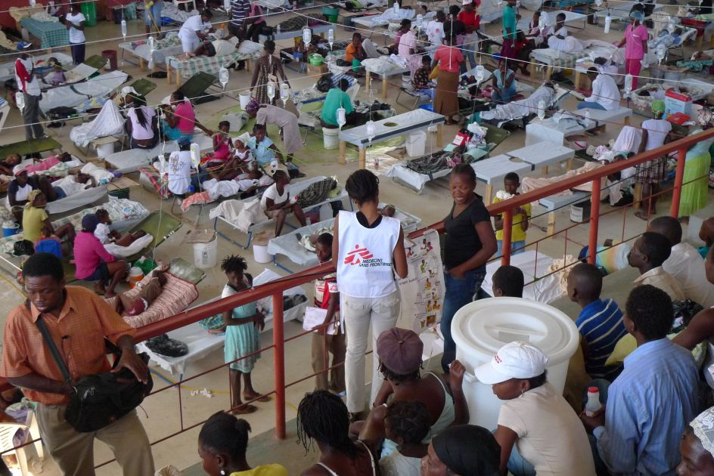
MSF cholera treatment centre in Haiti
Cholera is a serious risk in the aftermath of emergencies, like the Haiti earthquake of 2010, but can strike anywhere. The situation can be especially problematic in rainy seasons when houses and latrines flood and contaminated water collects in stagnant pools.
© Aurelie Lachant/MSF

Slide 74
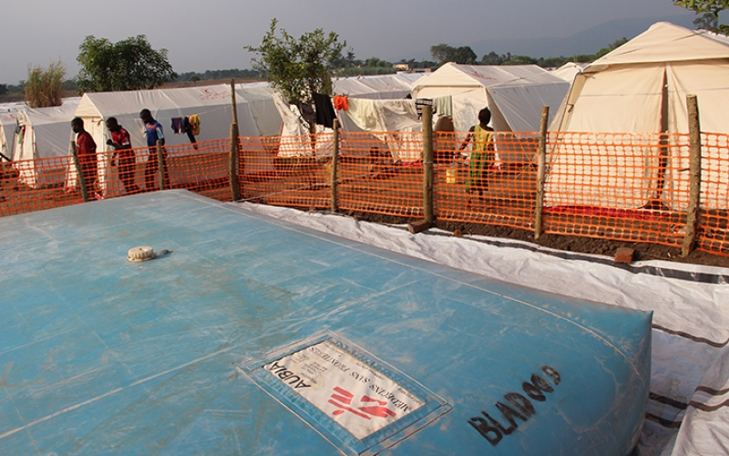
MSF supplies clean water
MSF’s water and sanitation engineers and logisticians play a vital role in the prevention of cholera. Pictured water bladder and tanks in Uganda helping refugees from the Democratic Republic of Congo. MSF also builds latrines and cleans wells.
Andres Romero / MSF

Slide 75
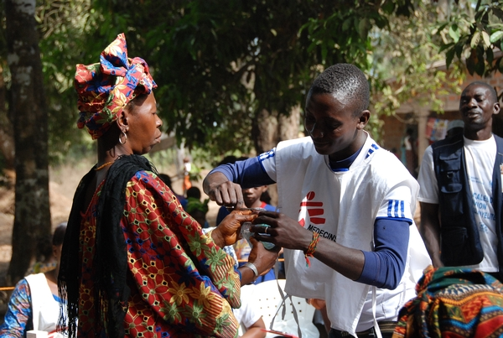
MSF vaccinates - in Guinea
© MSF

Slide 76
Acknowledgments
Thank you for using our resource. We would be pleased to receive your feedback. Email: schools@london.msf.org. Find out more about MSF: http://www.msf.org.uk
Many, many thanks to LSHTM for giving MSF permission to replicate parts of the first lecture of the LSHTM “Introduction to Epidemiology” course and the interactive, shorter version on their website. You can find the first editions of On the Mode of Communication in its archive or visit a public lecture in its John Snow theatre. Find out more about LSHTM: http://www.lshtm.ac.uk

Slide 77
Acknowledgments
Very special thanks to our Biology working group for kindly donating their time and giving us excellent input and guidance:
Yasmin Ghayur, Archbishop Tenison Church of England High School, Croydon;
Neil Hart, St. Saviour’s and St Olave’s School, Southwark;
Alexis Lacheze-Beer, Dulwich College, Dulwich;
Mei Lapuz, Camden School for Girls, Camden;
Shalika Lewis, Lilian Baylis, Lambeth;
Cecile Roquain and Subarna Paul, St Charles Catholic Sixth Form College, Kensington;
Alison Waldron, Coloma Convent Girls’ School, Croydon.
Thanks also to students Ellen Pearce-Davies, Shannon Bernard Healey and Tavishi Kanwar for their ideas.

Slide 78

